Slide 1
Learning at Low False Positive Rate
Scott Wen-tau Yih Joshua Goodman Learning for Messaging and Adversarial Problems Microsoft Research
Geoff Hulten Microsoft

Slide 2
Regular way
Give him lots of positive & negative examples to learn
Violent way
Punch him for false positive
Collaborative way
Train the 2nd using examples that the 1st thinks are spam

Slide 3
Regular way
Give him lots of positive & negative examples to learn
Violent way
10%
20% ~ 40%
Collaborative way
15% ~ 30%

Slide 4
Low False-Positive Region
Improving the whole ROC curve?
Fantastic! But…
0
(No missed spam)
We only care about low false-positive region!
(All spam missed)
1
0
(No good caught)
1
(All good caught)

Slide 5
Outline
Quick review of ROC curves
Methods to improve spam filters in low false-positive region
2-stage framework
Training with utility
Experiments
Related work
Conclusions

Slide 6
False-Positive vs. False-Negative
X: Ratio of misclassified good mail (FPR)
Y: Ratio of missed spam (FNR)
Statistical filter assigns scores to messages
Change behavior by choosing different thresholds
0
(No missed spam)
ROC curve
(All spam missed)
1
0
(No good caught)
1
(All good caught)

Slide 7
Properties of ROC Curves
ROC shows the trade-off between false positive (misclassified good mail) and false negative (missed spam) given different thresholds
θ = 0.5 may not be the best choice
Decide θ according to the ROC curve
The ranking decides the ROC curve, not the absolute scores.
For spam filtering, we only care about how much spam the filter can catch when the false-positive rate is low.
The cost of missing good mail is much higher than not catching spam!

Slide 8
Outline
Quick Review of ROC curves
Methods to improve spam filters in low false-positive region
2-stage framework (collaborative way)
Training with utility (violent way)
Experiments
Related work
Conclusions

Slide 9
2-Stage Framework: Idea
Forget easy good mail and hard spam
The messages that have low scores
They fall in the high false-positive region.
Try do a better job on other messages

Slide 10
Use 2-Stage Framework
We trained 2 models for these 2 stages
Apply the 1st-stage model on all messages
For messages having scores less than θ, don’t change the order or scores
Re-score and re-order the remaining messages using the 2nd-stage model

Slide 11
Train 2-Stage Framework (1/2)
The naïve way
Train the 1st-stage model as usual
Score the training messages using the 1st-stage model
Use the subset of training data whose scores are larger than θ as the training data for the 2nd-stage model
Problem
The scores of the training data tend to be too good and different from scores on unseen data
Solution: Use cross-validation

Slide 12
Why does 2-stage work?
Spam mail
The 2-stage framework provides more complex hypothesis space, which might fit the data better.
Suppose that the base model form is a linear classifier.
Pick the subset of the data in the region you care about.
Find all messages, good and spam, that are more than, say, 50% likely to be spam according to the first model.
Train a new model on only this data.
At test time, use both models.
Good mail
Good mail
Spam mail
Good mail
Spam mail

Slide 13
Training with Utility
Motivation again: why do we care more in the low false-positive rate region?
The “cost” or “utility” of a false positive error (misclassified good mail) is much higher.
A common approach is to select the right threshold to get the correct FP/FN trade-off
A less common approach is to “re-weight” the data (training with utility)
It's more important to get negative examples right
Duplicate negative examples 10 times and train the model on the new data

Slide 14
Work for Naïve Bayes?
Training with utility is usually used in non-probabilistic learning algorithms, such as SVMs, when the data is highly skewed.
It has been argued that training with utility has no effect on naïve Bayes
Only the prior changes
Probability is multiplied by a constant
Effectively, the decision hyperplane only shifts but not rotates

Slide 15
The Real Results
In practice, training with utility improves both naïve Bayes and logistic regression filters.
For naïve Bayes, smoothing is the key
Training with utility is equivalent to having different smoothing parameters for positive and negative examples.
For logistic regression, the hyperplane may both shift and rotate, even without smoothing.

Slide 16
Outline
Quick Review of ROC curves
Methods to improve spam filters in low false-positive region
2-stage framework
Training with utility
Experiments
Related work
Conclusions

Slide 17
Data
Hotmail Feedback Loop
Polling over 100,000 Hotmail users daily
Asked to hand-label a sample message addressed to him as Good or Spam
Very roughly 3% of user labels are errors
Training data (7/1/05 ~ 11/30/05)
5,000 msg per day; 765,000 msg in total
Testing data (12/1/05 ~ 12/15/05)
10,000 msg per day; 150,000 msg in total
Features (excluding proprietary features)
Subject keywords and body keywords

Slide 18
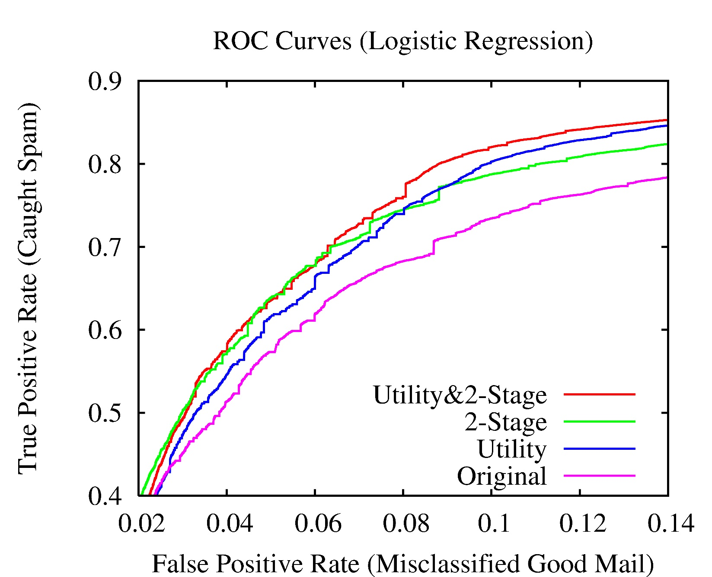
Logistic Regression (20% improvement)

Slide 19
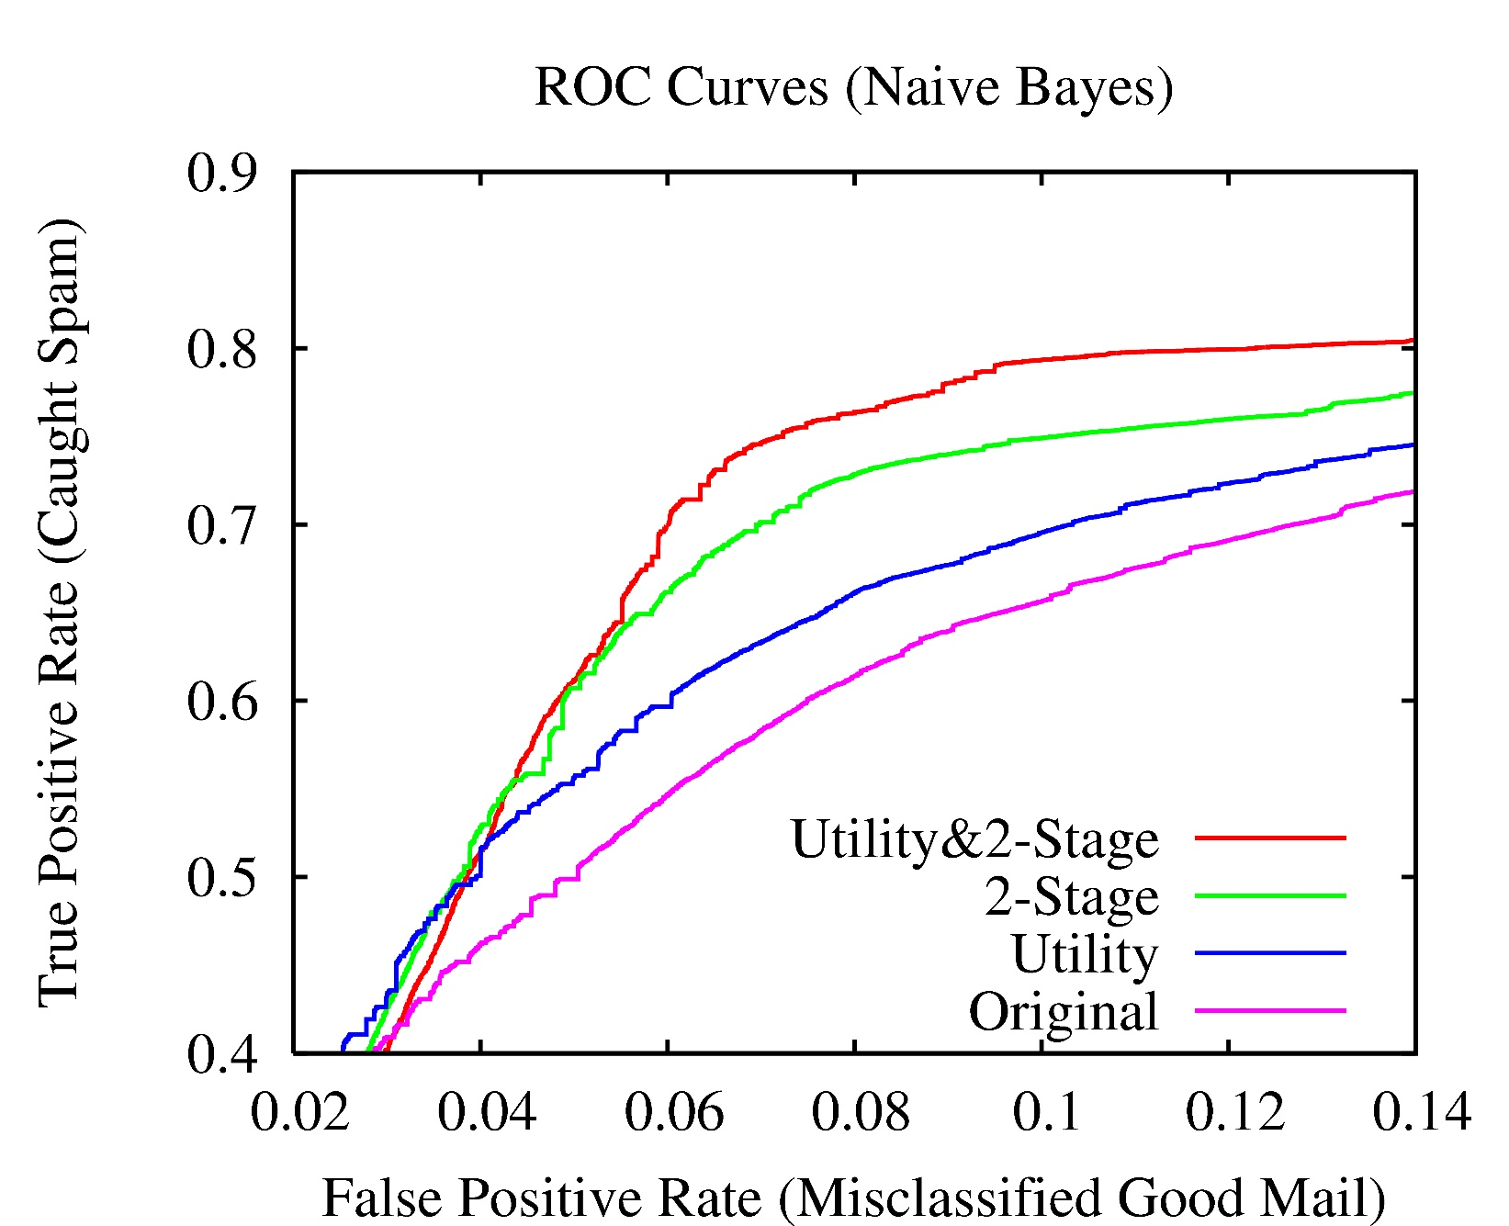
Naïve Bayes (40% improvement)

Slide 20
Related Work
2-stage framework
Different from Boosting
We specifically focus on low false-positive region
We use cross validation
We combine classifiers differently
A special form of decision list with only 2 layers, or cascade of classifiers ([Viola&Jones ’01], [Roth&Yih ’01])
Cascades improve overall accuracy or speed up the system
Cascades use more features or more complex models ain later stages
Training with utility
Has been done before – but not for spam we think
Typically used for unbalanced data as opposed to for emphasizing low false positive rate

Slide 21
Conclusions
Reduced false negative by 20-40% at low false positive rates.
Training with utility (10% for both NB and LR)
Two-stage filtering works even better (15% ~ 30%)
The combination works the best!
40% gain for Naïve Bayes
20% for logistic regression
Both techniques can potentially be used with most other learning methods
Key insight: by specifically targeting low false positive rate at training time can get better results.

